Slide 1
Product Backlog (User Stories)
Amir Dirin Spring 2023

Slide 2
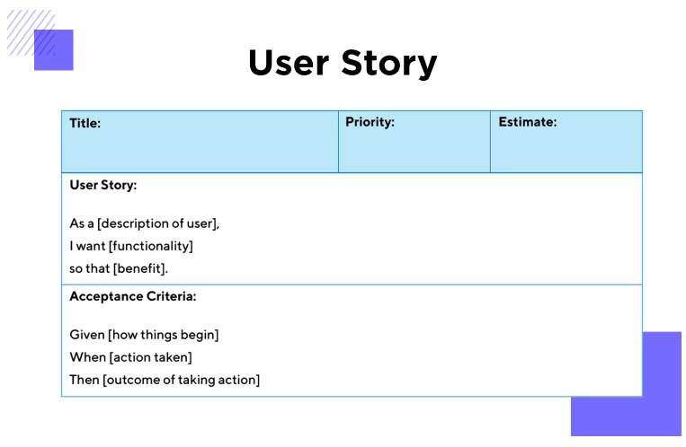
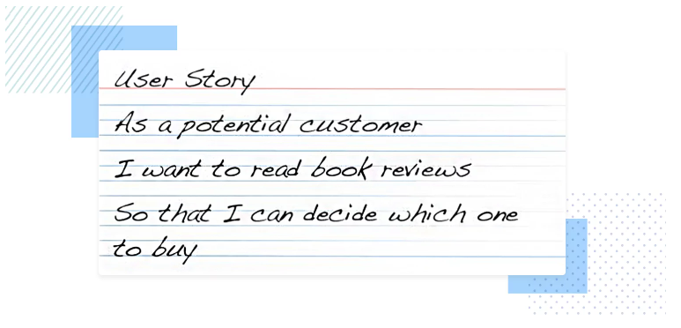
Product Backlog (User Stories)
As a team you have to come up with your product backlog. Use the user story approach to write done the product backlog.
User Stories:
“As a [persona], I [want to], [so that].”
https://www.justinmind.com/blog/user-story-examples/

Slide 3
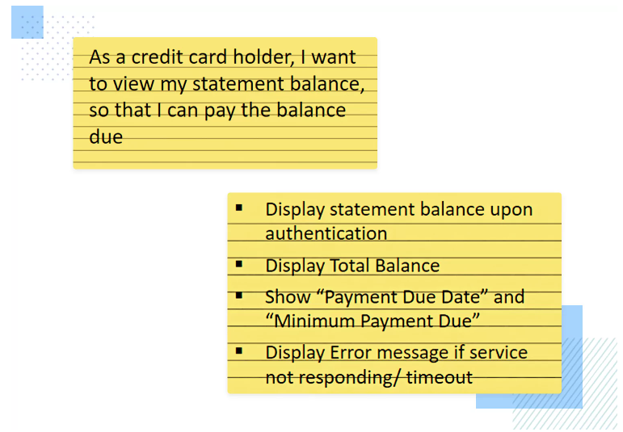

Slide 4
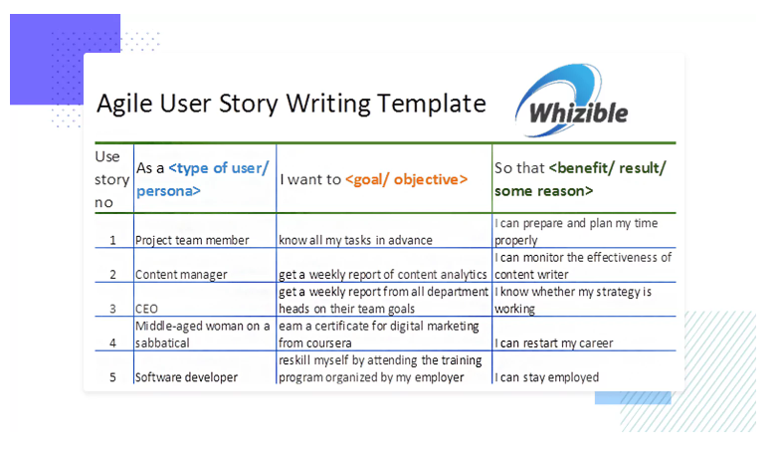
Example contiue

Slide 5
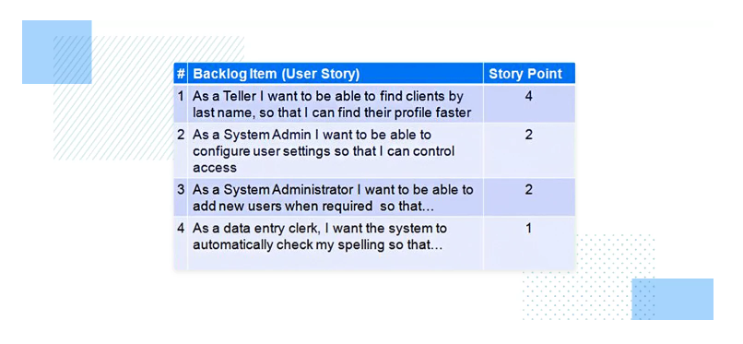

Slide 6
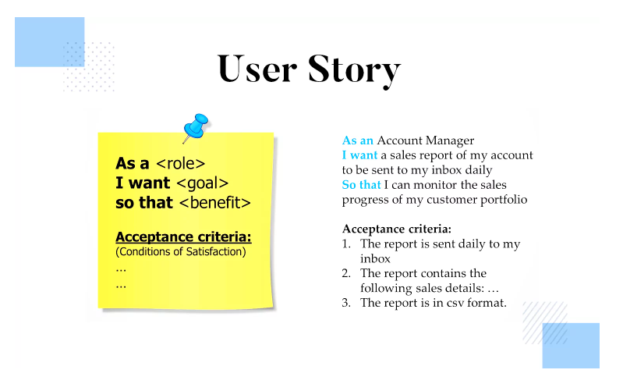

Slide 7
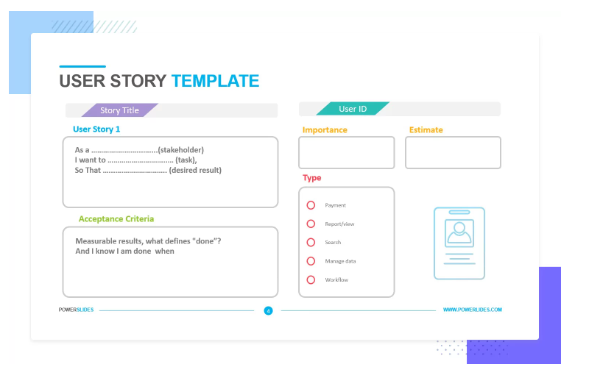
Example

Slide 8
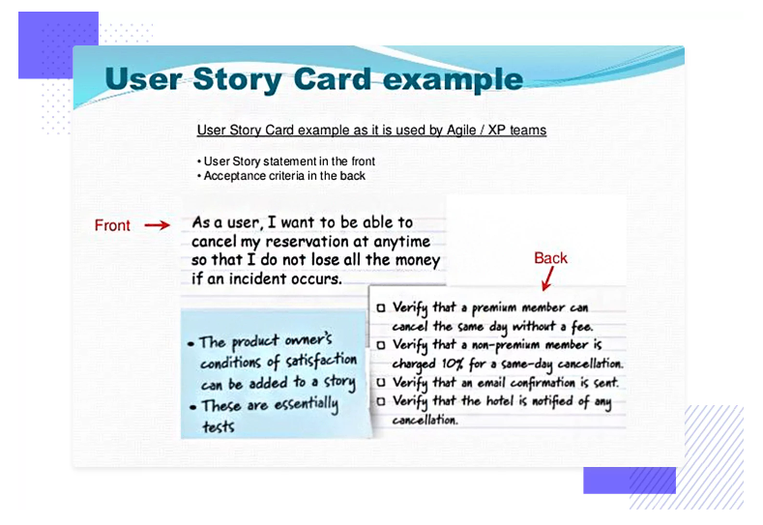
Example

Slide 9
